Slide 1
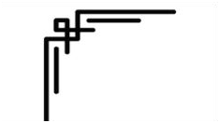







Presented by
Prestige Institute of Engineering Management and Research (PIEMR), Indore

Slide 2




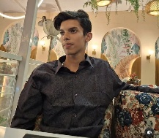

Team Profile
TRACK / PROBLEM STATEMENT
TERRA02 - Industrial Pollution Source Attribution Engine
Ashar Azam
Lalita Jhapate
TEAM NAME
DeveloperX
TEAM LEADER'S NAME
Afsar Azam
Ayush Singh
EMAIL ADDRESS
afsarazam404@gmail.com
TEAM MEMBERS
Afsar Azam – Model Integration & Frontend & Backend
Lalita Jhapate – Preprocessing & Model Training
Ayush Singh - Deployment & Documentation

Slide 3

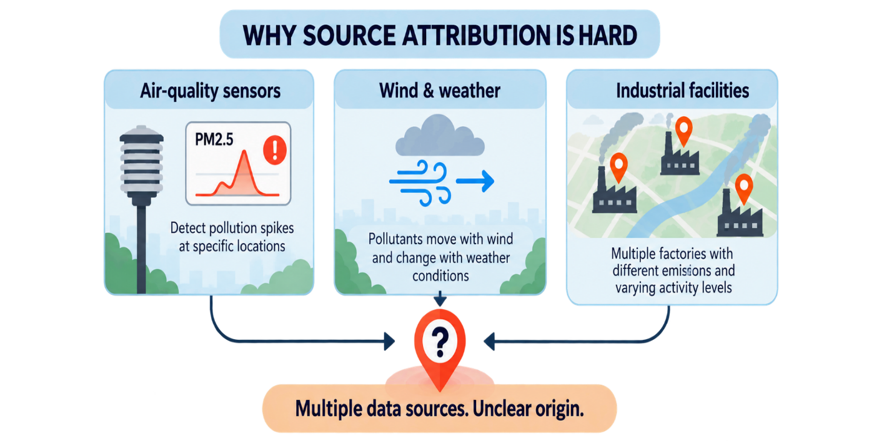
Problem Statement - Air-quality sensors detect pollution, but identifying the industrial sources responsible is difficult because pollution movement depends on wind, weather, location and time.
Pollution Detected. Source Unknown
Unidentified Sources: Sensors detect pollution but cannot pinpoint the responsible factory.
Scattered Data: Air quality, wind, and factory data are disconnected.
Slow Investigation: Finding likely sources requires time and analysis.
Uncertain Evidence: Lack of clear evidence makes attribution difficult.
Key Challenge: Which factories are the likely sources of pollution, and what evidence supports it?

Slide 4


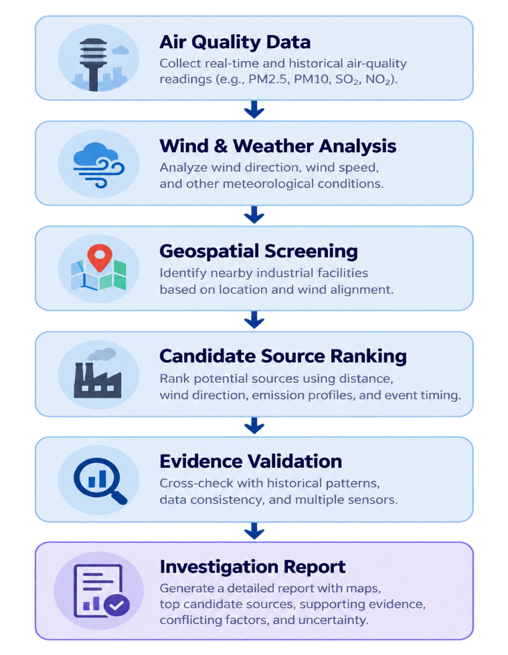
Solution Approach – AIR KAVACH - From Pollution Detection to Explainable Source Attribution
• COLLECT
Gather air-quality, weather, wind, and factory-location data.
• ANALYZE
Detect pollution spikes and analyze wind patterns.
• IDENTIFY
Screen nearby factories using distance and wind alignment.
• PRIORITIZE
Rank likely sources and assess evidence reliability.
• EXPLAIN & REPORT
Present source rankings, evidence, and uncertainty.
Detect the spike. Trace the source. Explain the evidence.

Slide 5
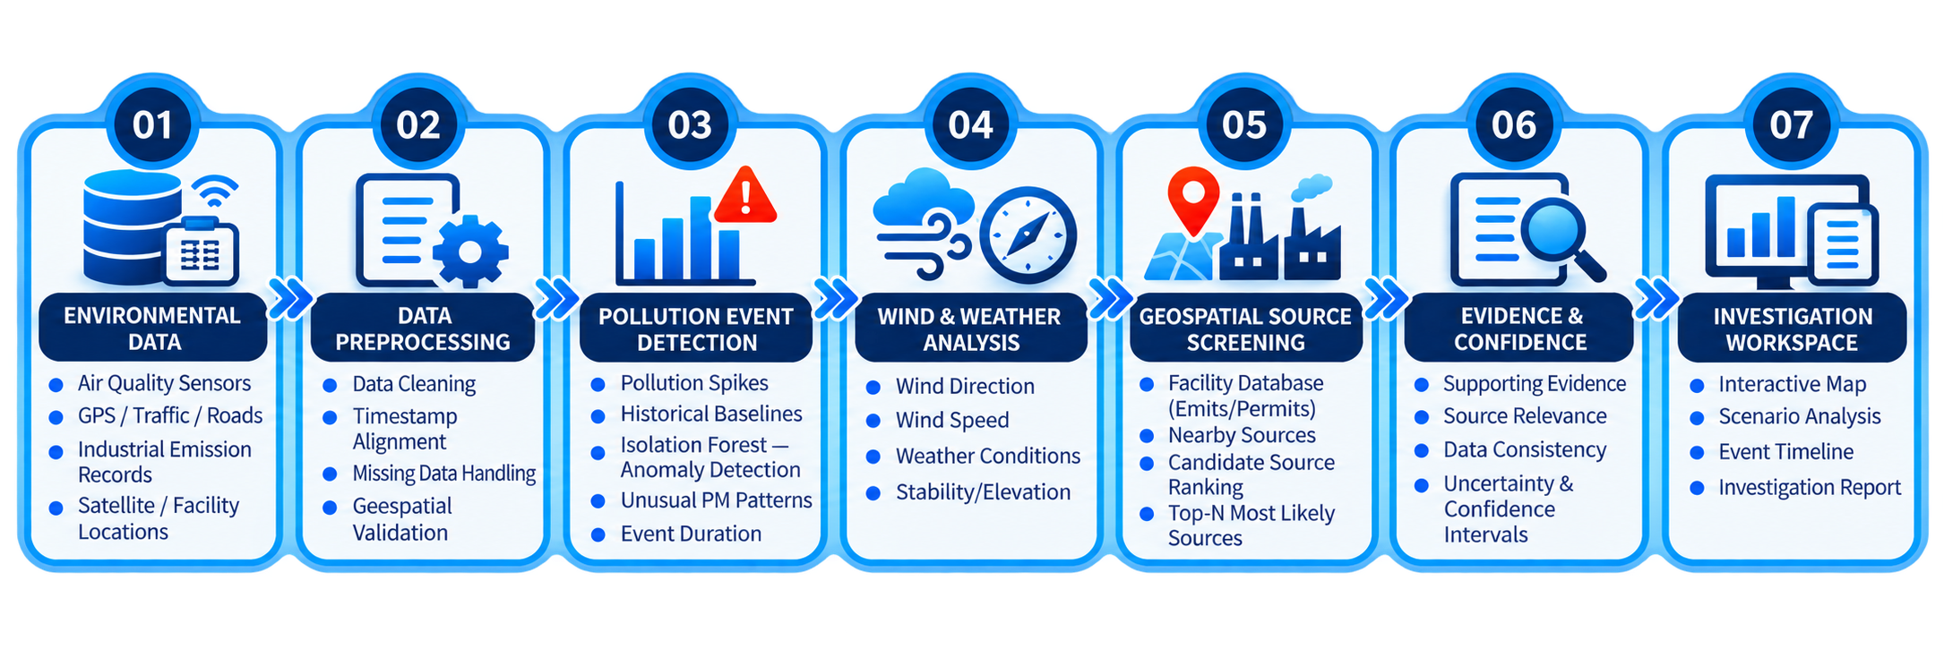
Workflow
AIR KAVACH transforms environmental observations into structured investigation insights by combining air-quality data, weather analysis, geospatial screening and evidence assessment to identify potential industrial pollution sources.
Collect → Preprocess → Detect → Analyse → Screen → Validate → Investigate

Slide 6
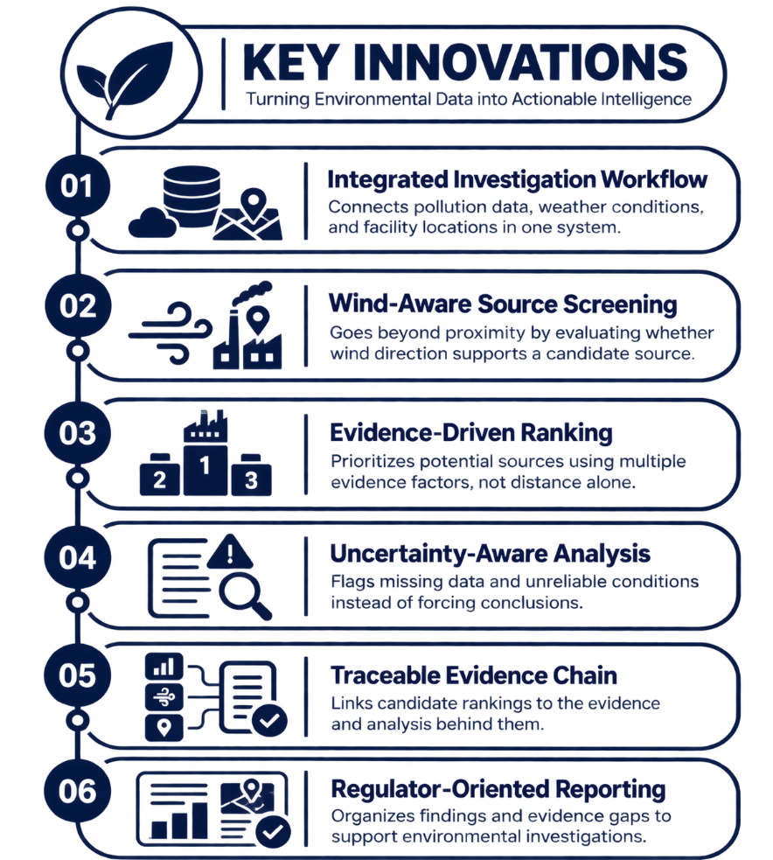
Key Features & Innovation
KEY FEATURES
01. Multi-Source Integration
Combines air-quality, weather, wind, and facility data.
02. Pollution Detection
Identifies unusual pollution spikes.
03. Wind & Geospatial Analysis
Analyzes wind patterns and facility distances.
04. Source Ranking
Ranks potential industrial sources using available evidence.
05. Evidence & Uncertainty
Highlights evidence gaps and data limitations.
06. Automated Reporting
Generates structured investigation reports.

Slide 7
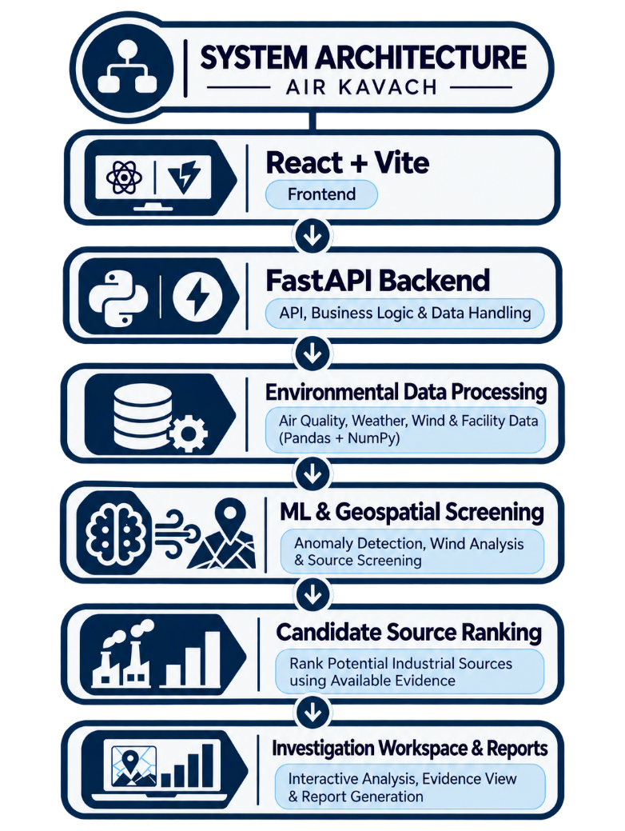
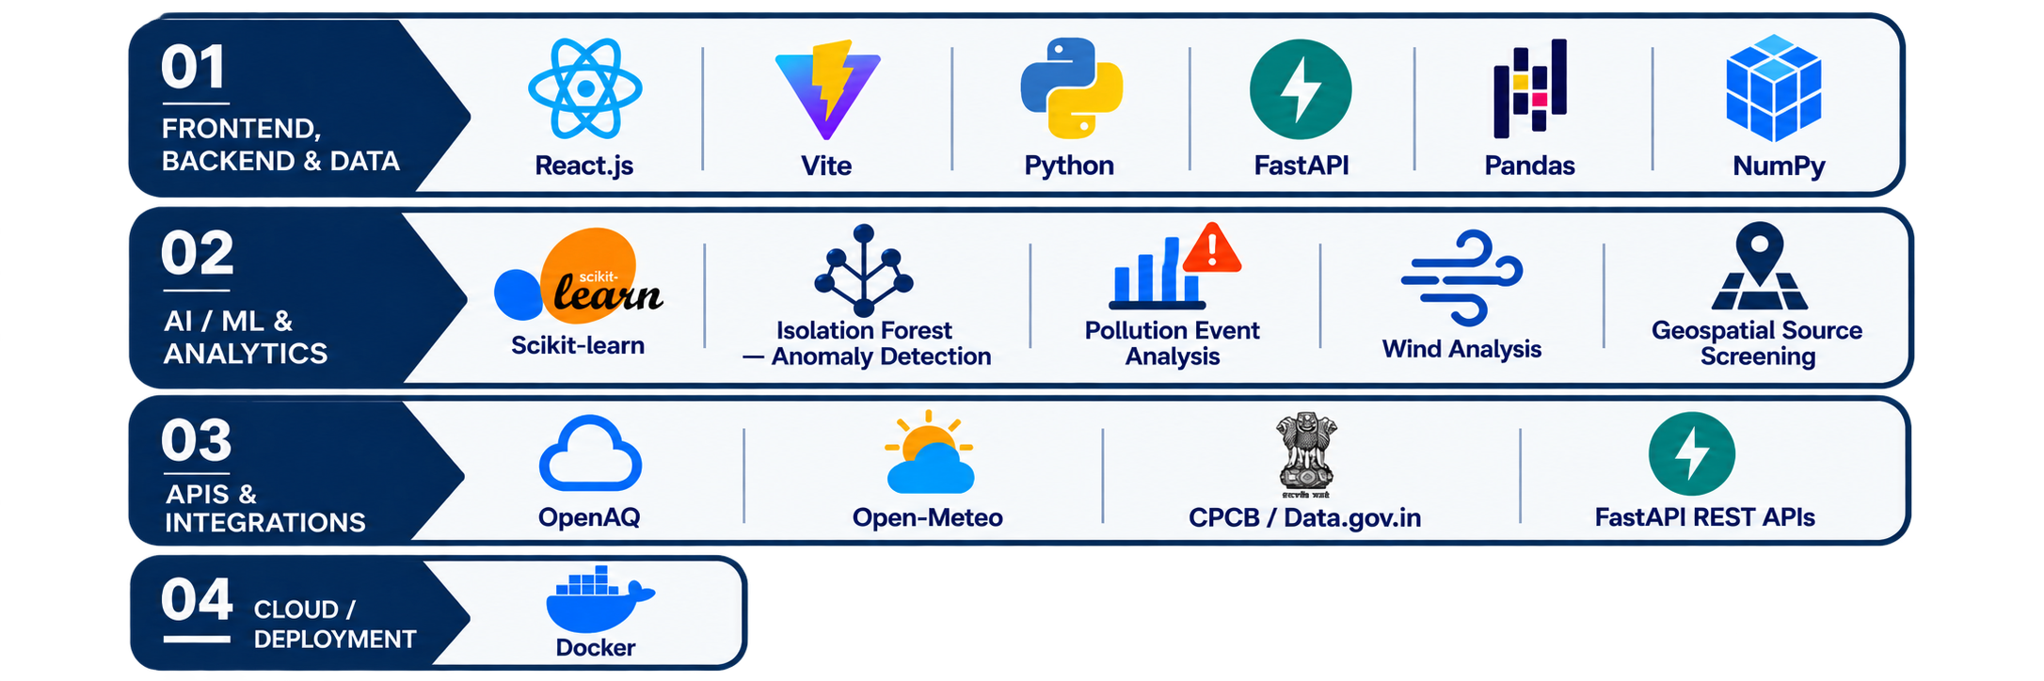
Technology Stack

Slide 8
Feasibility & Viability
Feasibility
Viability
🔹 TECHNICAL FEASIBILITY
Uses Python, FastAPI, Machine Learning and geospatial analysis to investigate potential pollution sources.
🔹 DATA AVAILABILITY
Can use available air-quality observations, weather data and industrial facility locations.
🔹 IMPLEMENTATION FEASIBILITY
Supports pollution event detection, wind analysis, candidate source screening and evidence report generation.
🔹 SCALABILITY
Designed to support different regions when compatible environmental data and facility locations are available.
🔹 COST-EFFECTIVE DEVELOPMENT
Uses open-source technologies such as Python, FastAPI and Scikit-learn to reduce software development costs.
🔹 ACCESSIBLE DATA SOURCES
Can leverage available public environmental datasets, subject to access, licensing and API limitations.
🔹 PRACTICAL APPLICATION
Helps environmental analysts prioritize potential pollution sources and organize investigation evidence.
🔹 FUTURE EXPANSION
Can be extended to additional regions as reliable air-quality, weather and industrial facility data become available.

Slide 9
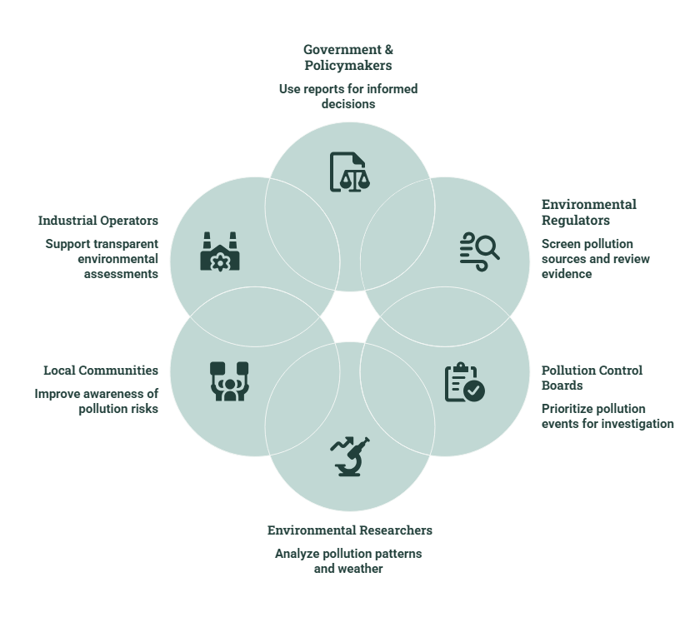
Impact & Benefits
Impact
01. ENVIRONMENTAL PROTECTION
Supports industrial pollution investigations.
02. INFORMED ENVIRONMENTAL ACTION
Helps prioritize pollution investigations.
03. PUBLIC HEALTH AWARENESS
Improves awareness of pollution risks.
04. RESPONSIBLE INDUSTRIAL MONITORING
Promotes evidence-based source assessment.
05. REGIONAL ENVIRONMENTAL INTELLIGENCE
Supports expansion across different regions.

Slide 10










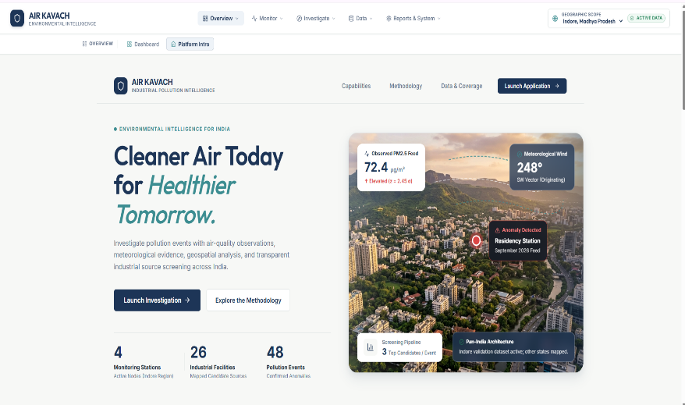
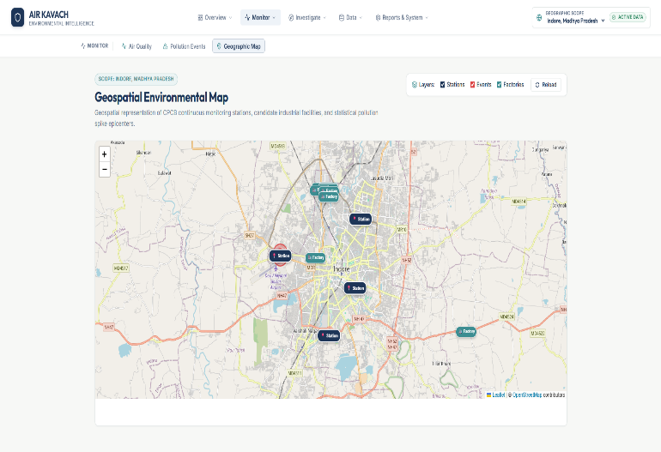
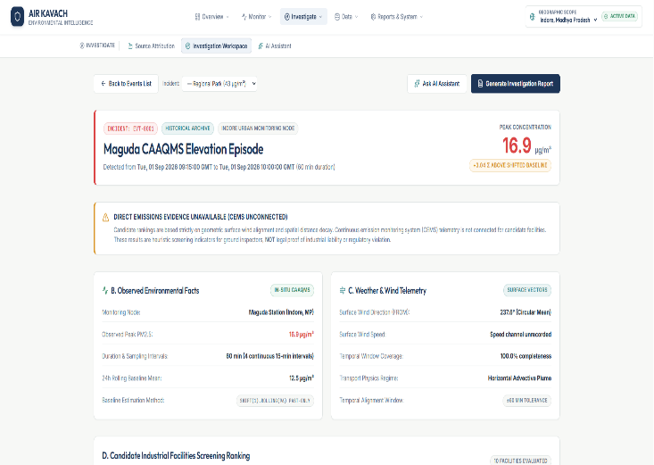
References

